Slide 1



BABY PRODUCTS MARKETING ANALYSIS
PRESENTED BY:
Kendonisha Reckley
Xavier Wildgoose
Faleesha Forbes
Topic : Marketing - Customer Relationship Management

Slide 2

Goal
Increased customer satisfaction, improve loyalty, and drive higher sales from our Customer Relationship Management (CRM) strategy. Businesses and individuals can better meet parents' and caregivers' needs by leveraging data and feedback.
Using data from Amazons best selling baby products, we will create a Baby Product Recommendation System Dashboard.

Slide 3


Objectives
A CRM strategy can benefit an industry focused on products for parents and caregivers, especially when implemented effectively.
Data Utilization
Discover patterns and preferences among customers through data exploration. Using the Primary DataSet, tailor our CRM approach.
Back to Agenda
Notes:
In Tools

Slide 4
Primary Data Source
Assumptions
Brand Name Significantly Influences Purchasing Decisions
Product Popularity Correlates with Ratings
Limitations
Lack of Detailed Consumer Demographics
Incomplete Representation of Consumer Preferences
Data Dictionary Highlights
ProductID
Price
Brand
Tools Used
Python
Tableau

Slide 5


What can data do for your business?
Marketing data gives businesses valuable insights into customer behavior, market trends, and campaign performance. By analyzing this data effectively, businesses can optimize their strategies, increase their ROI, and stay ahead of the competition.
Tracking and reviewing data from business processes helps you uncover performance breakdowns so you can better understand each part of the process and know which steps need to be fixed and which are performing well.

Slide 6





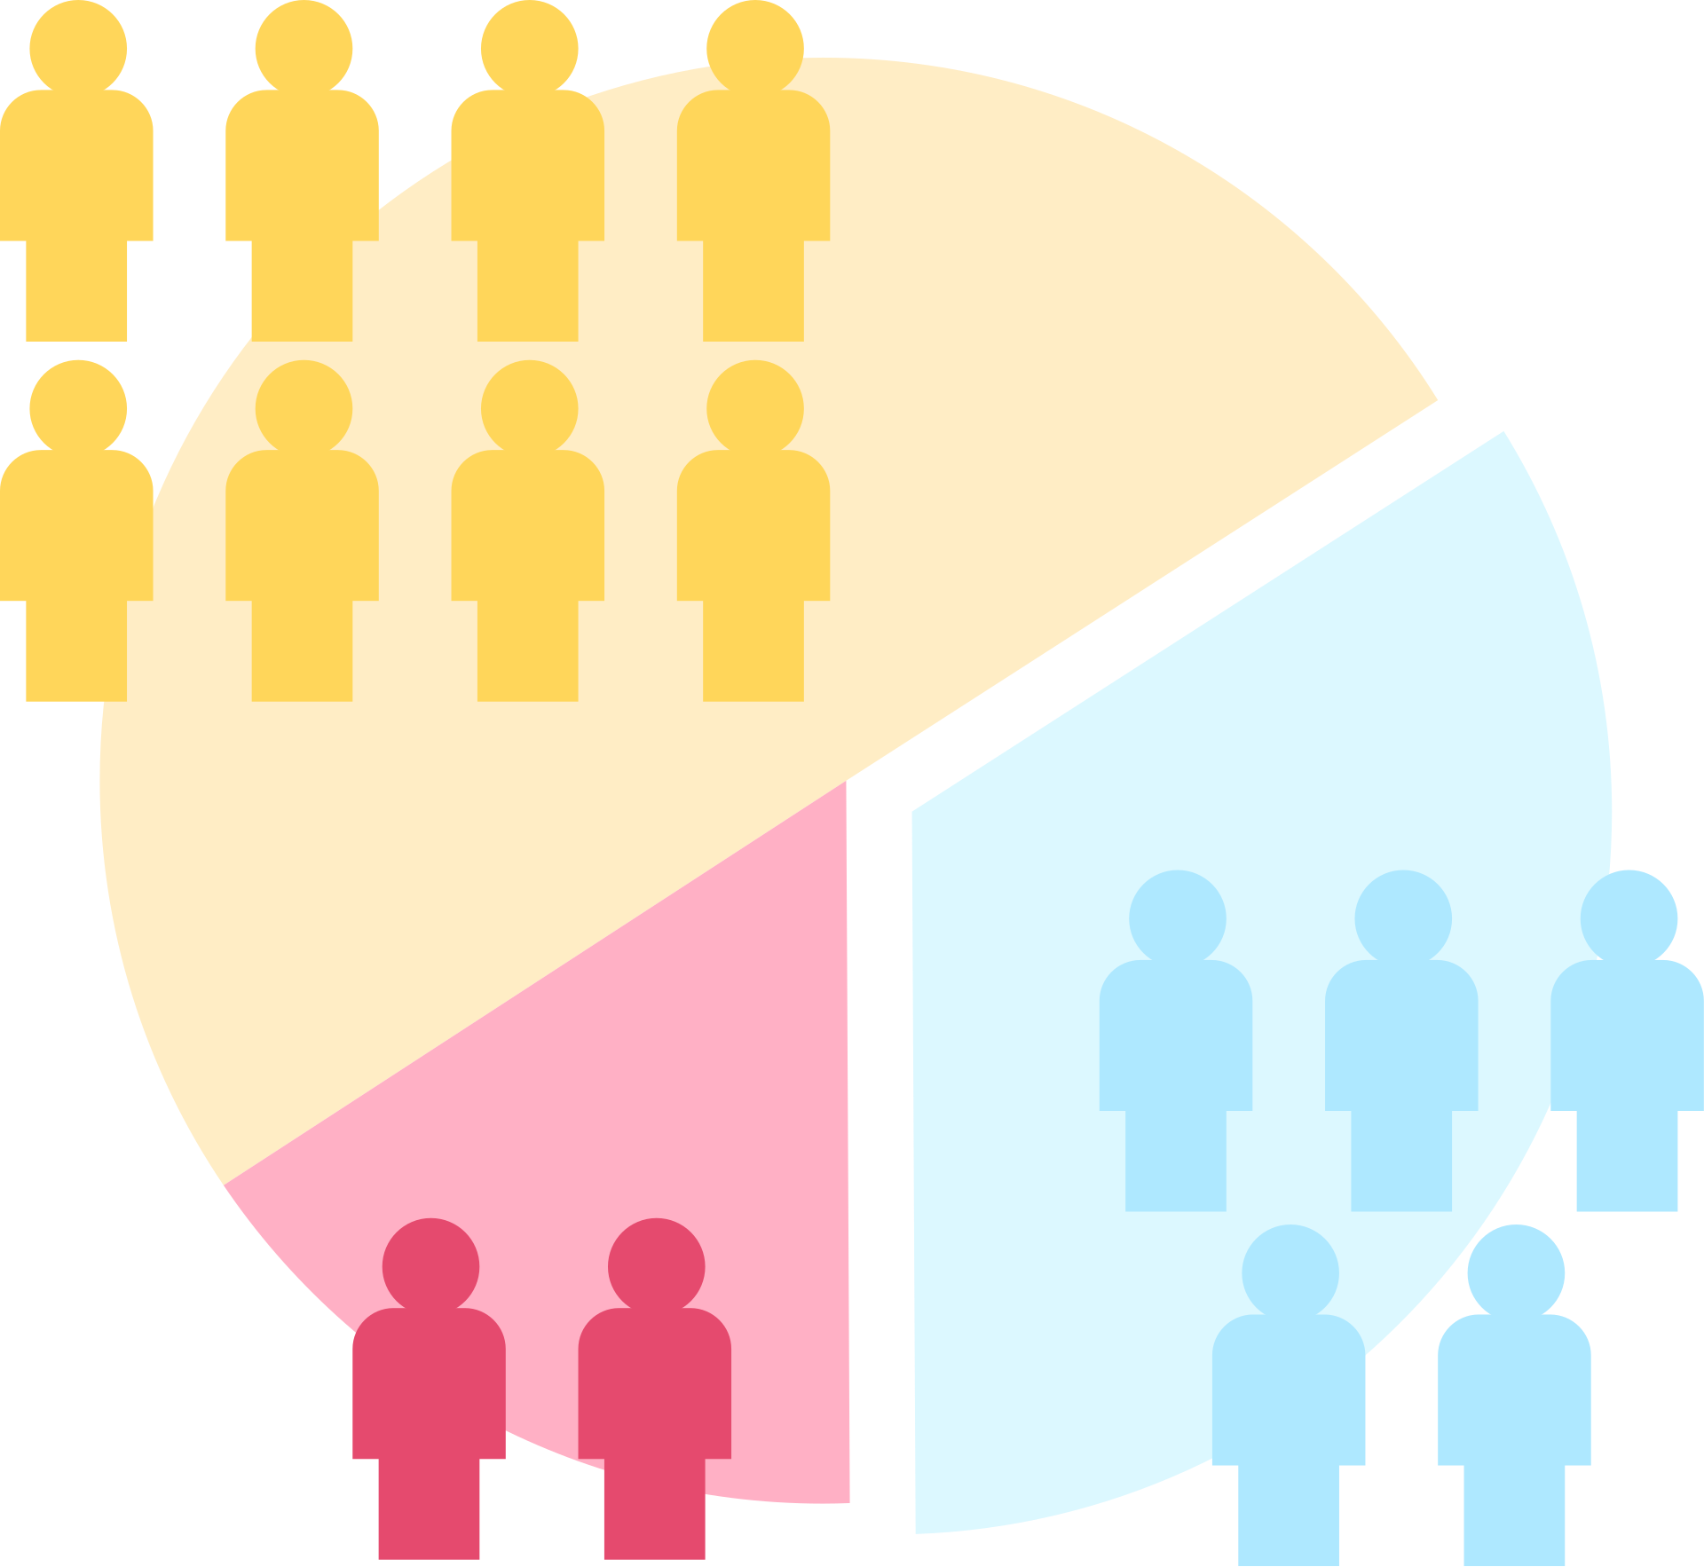



5 Ways to leverage Data
Cohort Analysis
Funnel Analysis
Segmentation
Tracking
Click Through Analysis

Slide 7
Customer Segmentation
Segment your customer base based on various criteria such as purchase history, preferences, and demographics. This allows for targeted communication and personalized experiences.

Slide 8
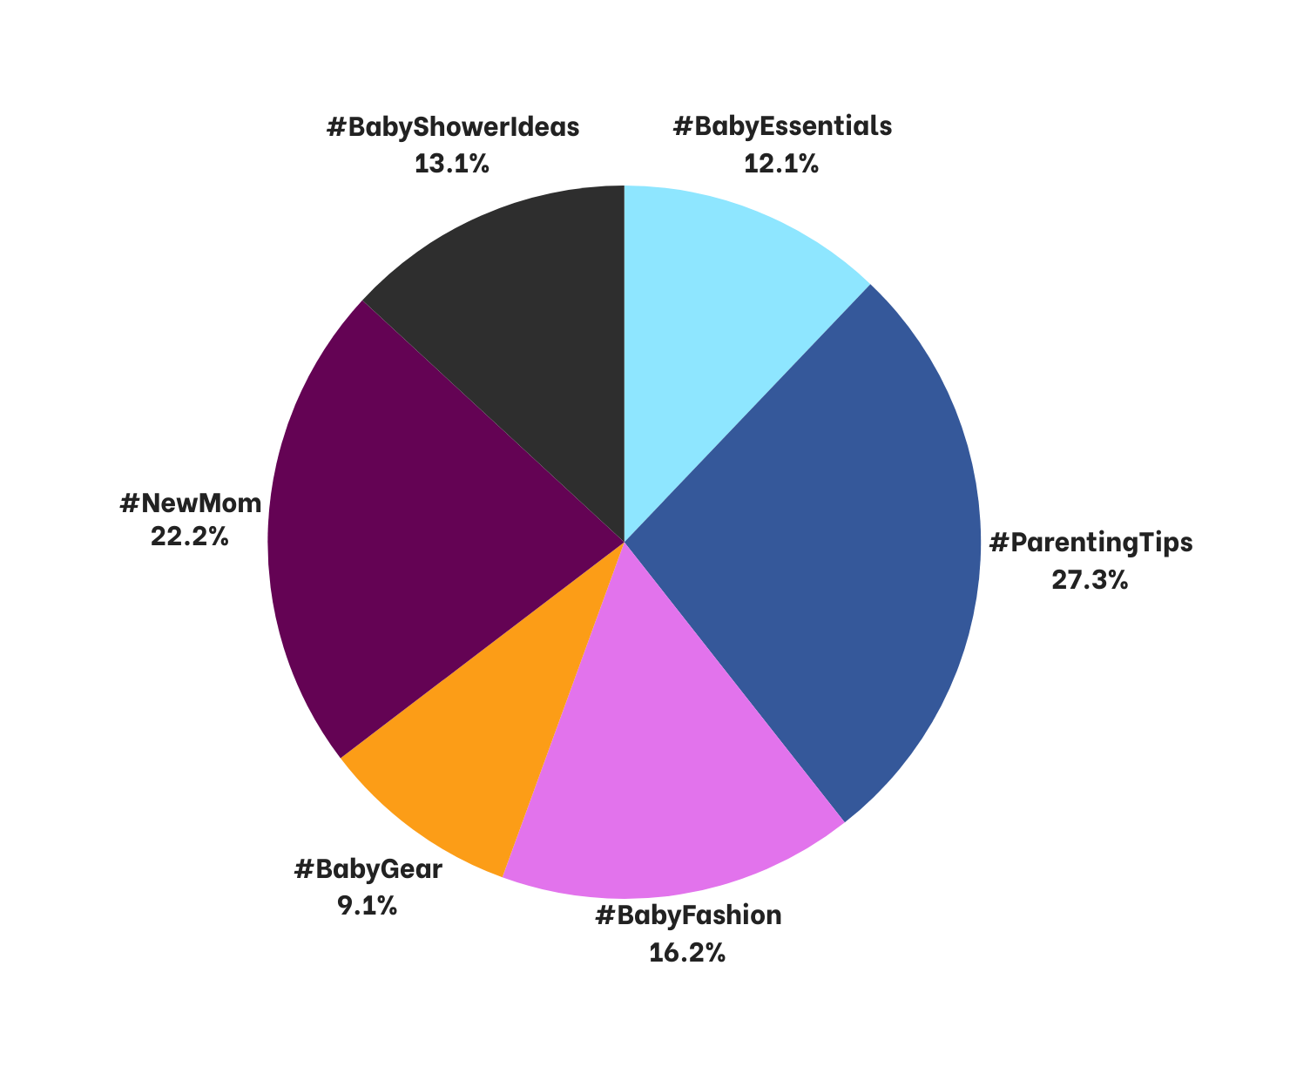


#BABYSHOWERIDEAS
#BABYESSENTIALS
SOCIAL MEDIA TRENDS
#PARENTINGTIPS
#BABYFASHION
Instagram Trends
Baby 35.6 M Post
#BABYGEAR
#NEWMOM
@instagram from 2/9/24
Notes:
Analyzing post counts under popular hashtags is valuable for identifying emerging trends and consumer interests. Using this data, we create content, engage audiences, and recommend products on social media

Slide 9


Stategy 3
Influencer partnerships
Stategy 1
Social Media Marketing
Common Marketing Strategies
Stategy 2
Stategy 4
Email Marketing
Content marketing
Notes:
These strategies generate valuable data on customer behavior, preferences, and engagement.

Slide 10
Why a Baby Product Recommendation System Dashboard?
A solution to leverage the data collected from marketing efforts and social media trends.

Slide 11
Data-driven recommendations :Benefits:
Boost product recommendations' accuracy and relevance.
Offer products aligned with customer interests and needs to increase loyalty.
Drive revenue and sales through targeted recommendations.
Notes:
Accuracy and Relevance
Products aligned with customer interests which increases loyalty
Targeted recommendation through sales

Slide 12





Brand Highlight-Burt’s Bees
Back to Agenda
NewBorn Clothing Rank #1
In the top 5 Amazon products by revenue in the newborn clothing sub-category
Sustainable and Organic Materials
Burt's Bees Baby emphasizes eco-friendly, organic newborn clothing, meeting consumer demand for sustainability.
Diverse Product Offerings
Burt's Bees Baby: diverse, innovative baby products beyond clothing, showcasing versatility and comprehensive care.

Slide 13
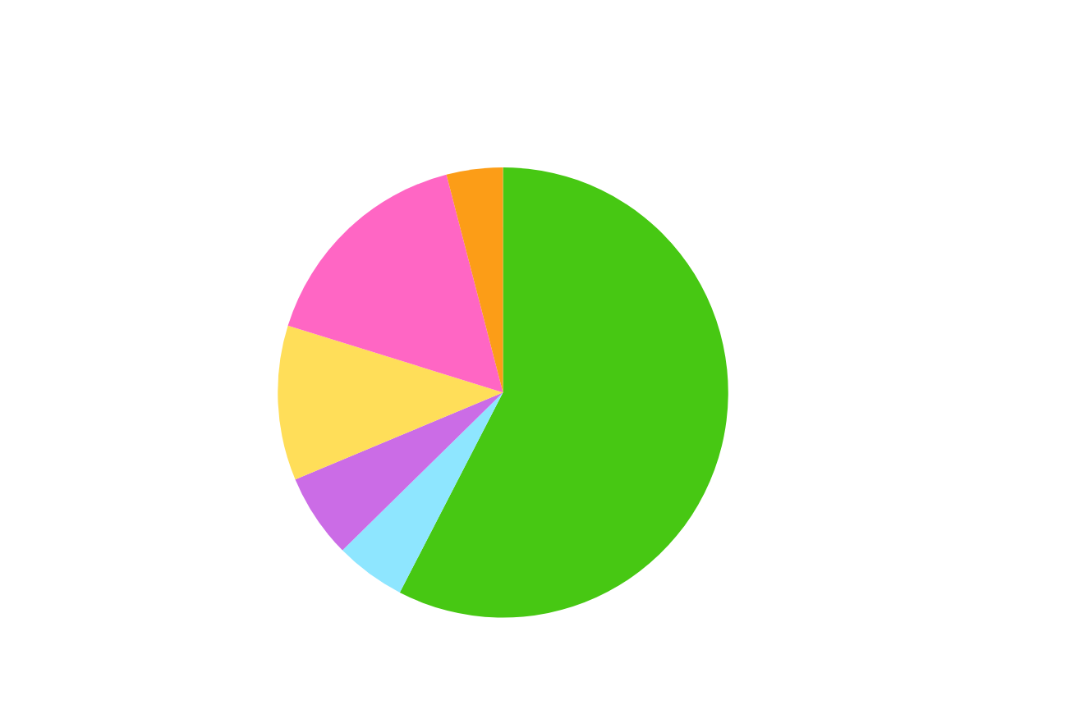
Overall Unit Sales | Overall Revenue | Average Product Price
1M (-72% YoY) | $29M (-71% YoY) | $28.46 (-6% YoY)
NEWBORN CLOTHING
Top 5 Brands by Market Share
Period: January 1, 2023 - May 4, 2023

Slide 14
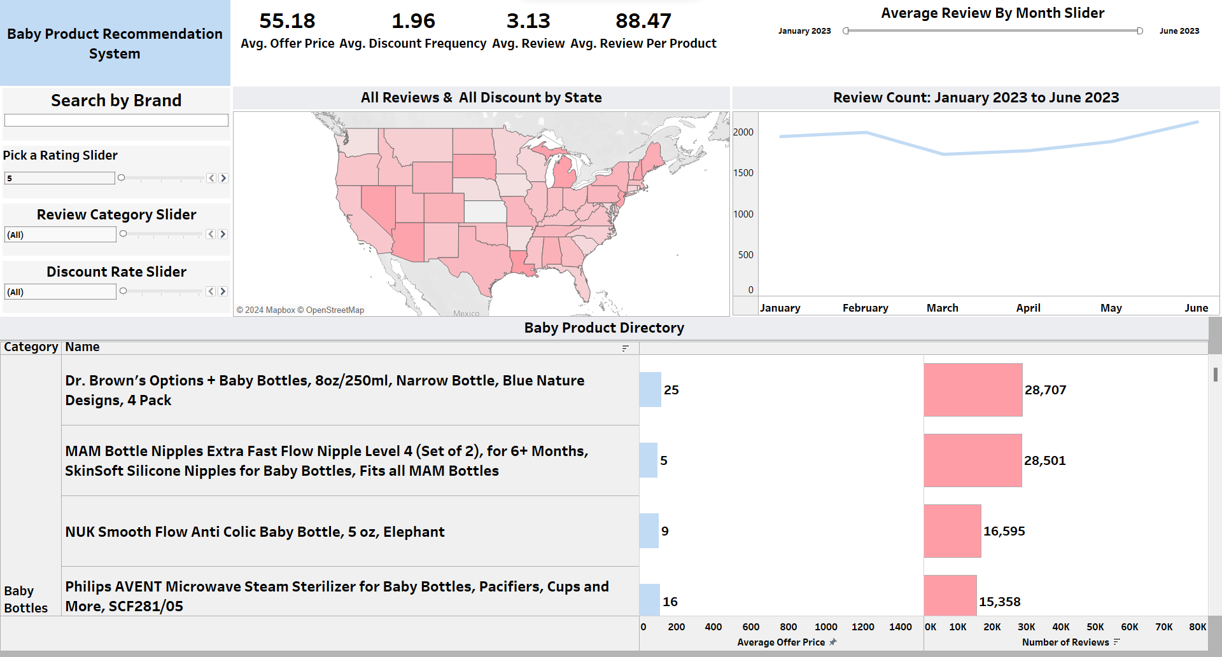

Slide 15




End
Thank you
Contacts:
faleeshaforbes@hotmail.com
xjwildgoose@gmail.com
kendonishareckley@gmail.com
;

